Slide 1

SQL Server Integration Services
Bryan Cafferky
Technology Solutions Professional

Slide 2
SSIS
Features
Flexible Configuration
Transparency/Visibility
Automated Deployment
Database Integration Service
Scale Out
ADFv2 – SSIS on Azure (in preview)

Slide 3
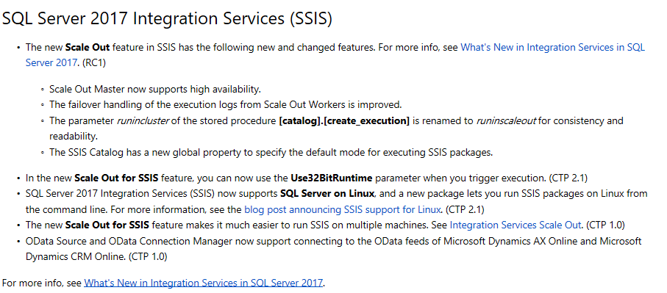
SQL Server 2017

Slide 4
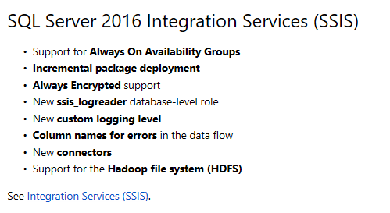
SQL Server 2016

Slide 5
SSIS
Architectural Details
New Architecture Addresses Many SSIS Limitations!
New SSIS Catalog in SQL Server managed via SSMS.
Built-in SSRS Reports on package executions.
Project Deployment Model: All the packages in the project are deployed together.
Configurable Project and Package parameters.
Environments – containers of configurations settings.
True database service execution.

Slide 6
SSIS
Configuration Improvements
Project Deployment Model
All the packages in the project are deployed together.
Packages in the project can share Parameters and Connection Managers.
Parameter and Configuration Values can easily be configured in SSMS.
The Legacy Package Deployment Model is available but does not support the above features.

Slide 7
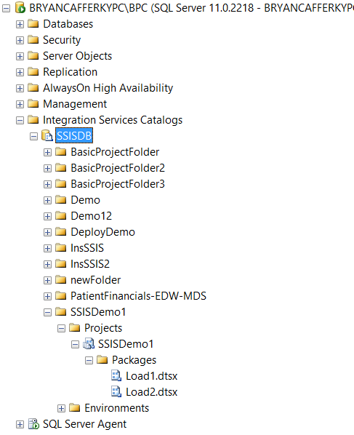
SSIS
Drum roll……The ssis catalog!

Slide 8
Demo

Slide 9
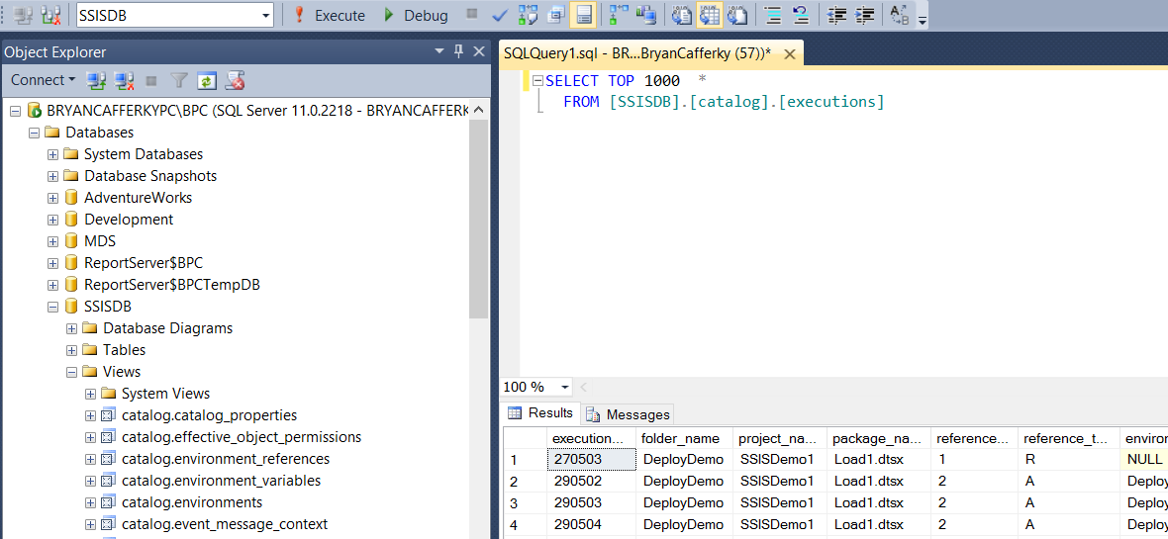
SSIS
Ssis catalog views – The dba’s dream come true

Slide 10
SSIS
A Simple project example

Slide 11
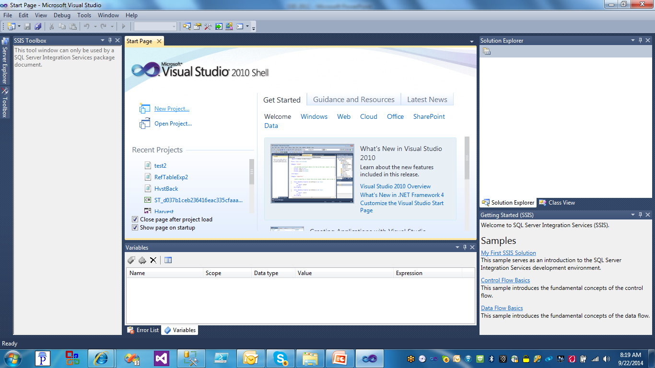
SSIS
Creating a Project
Click on New Project

Slide 12
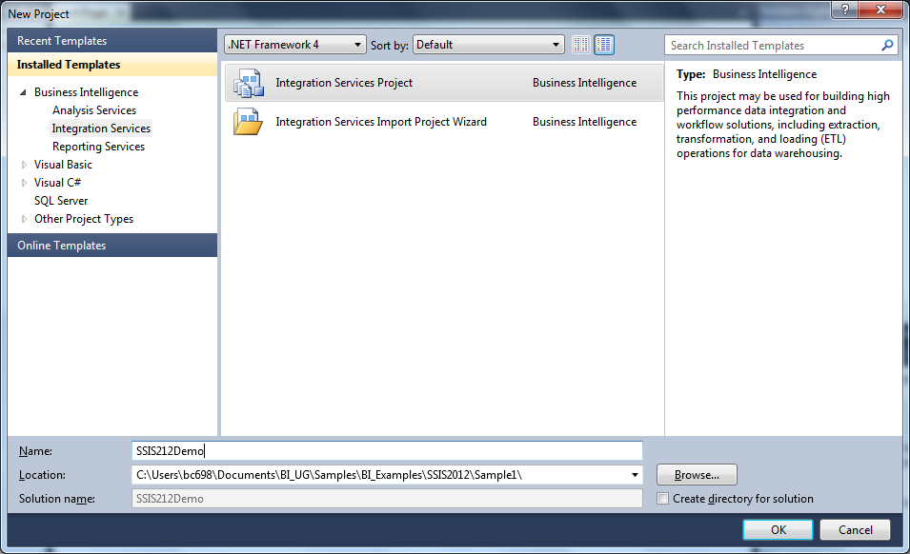
SSIS
Creating a Project
Click on Integration Services Project

Slide 13
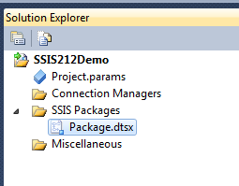
SSIS
Creating a Project – Project Level Configuration
New in 2012 – Project Parameters
And
Project Level Connection Managers

Slide 14
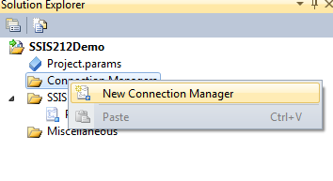
SSIS
Creating a Project – Project Level Configuration
Right Mouse Click and Select New Connection Manager to create a Project Level Connection Manager

Slide 15
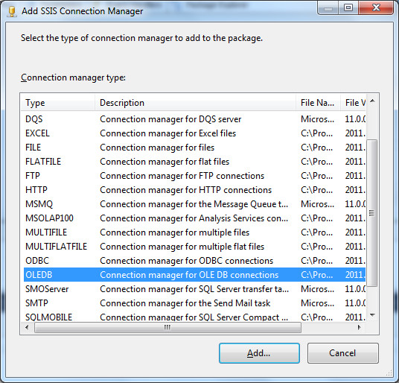
SSIS
Creating a Project – Project Level Configuration
Select the Connection Type. OLEDB is the most common, i.e. SQL Server.

Slide 16
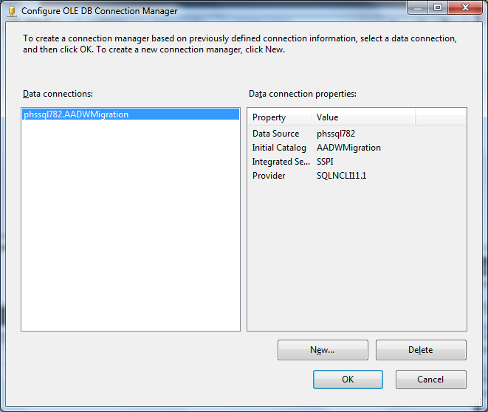
SSIS
Creating a Project – Project Connection Manager
Enter the Connection Properties.

Slide 17
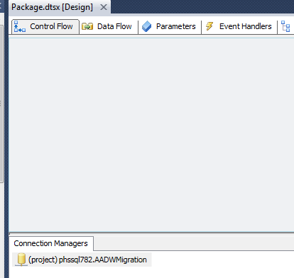
SSIS
Creating a Project – Project Connection Manager
Note: (project) indicates this is a Project Level Connection Manager.

Slide 18
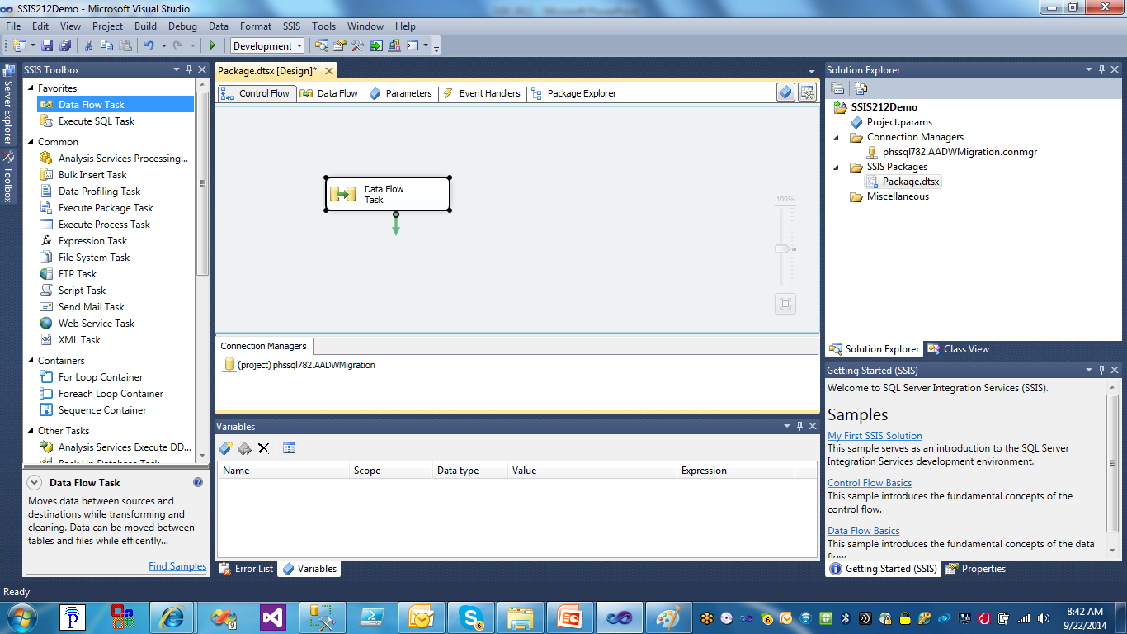
SSIS
Add a Data Flow.
Creating a Project – Project Connection Manager

Slide 19
SSIS
Parameters:
Variables that can be configured externally.
Can be scoped to the package or project.
Variables can get their value from a parameter.

Slide 20
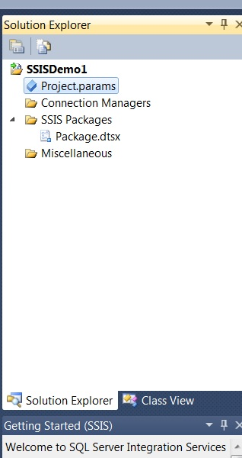
SSIS
Creating a Project – Project Parameter
Double Click on the Project.parameters to create Project Parameters.
Project Parameters are just Project Level scoped variables but they are exposed
To the Configuration Editor in SSMS and SQL Agent.

Slide 21
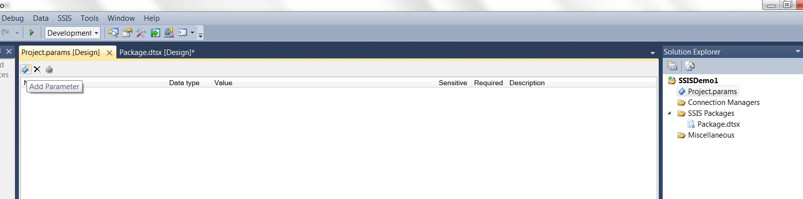
SSIS
Creating a Project – Project Parameter
Click on the Add Parameter Icon

Slide 22
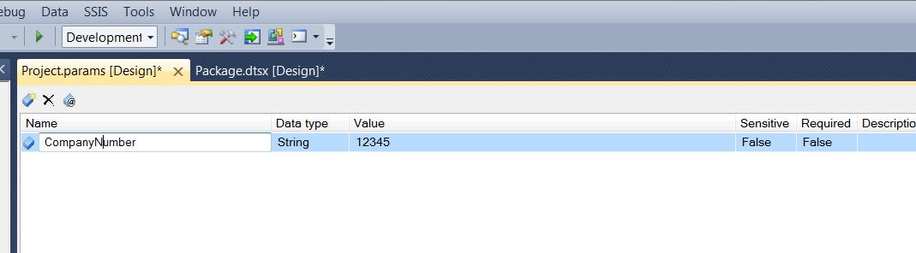
SSIS
Creating a Project – Project Parameter
Enter Parameter Details

Slide 23
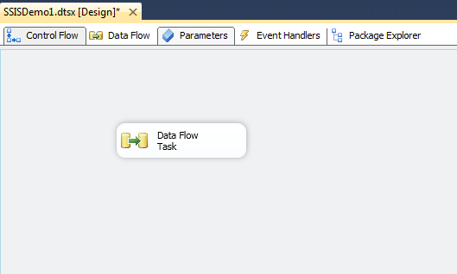
SSIS
Creating a Project – package Parameter
With a package open, click on the Parameters tab so we can create Project Parameters.

Slide 24
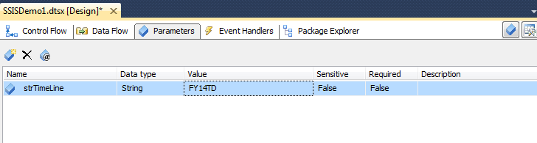
SSIS
Creating a Project – PACKAGE Parameter
Create a new Parameter. You can make it required.

Slide 25
SSIS
Deploying a project overview
Loads the entire project, i.e. all packages with current settings to the SSISDB in the Integration Services Catalogs.
Can be exported from the catalog as needed and restored to a Data Tools project.
Packages can be configured in the catalog and executed from the catalog.
SSISDB is a central repository for SSIS packages on a given SQL Server instance.

Slide 26
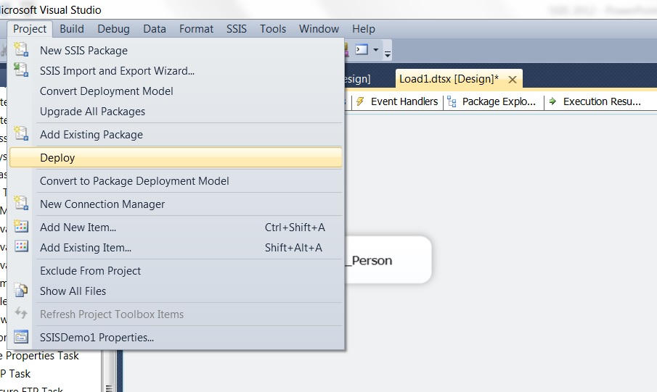
SSIS
Deploying a project – Step 1
Click on Project and then Deploy.

Slide 27
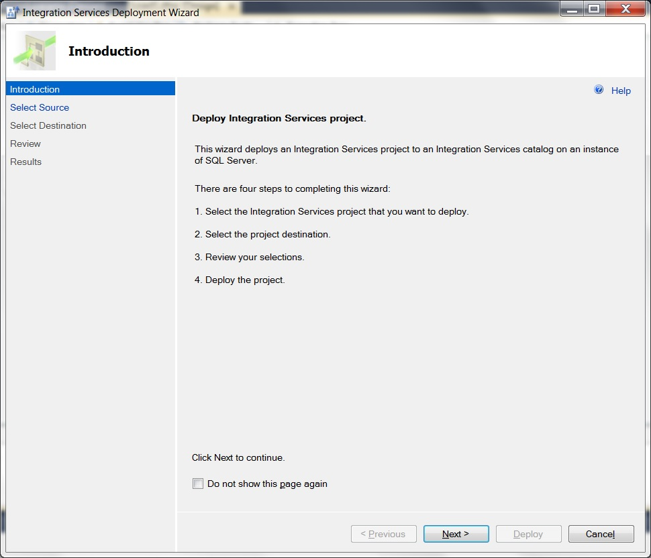
SSIS
Deploying a project – step 2
The Deployment Steps screen. Click Next.

Slide 28
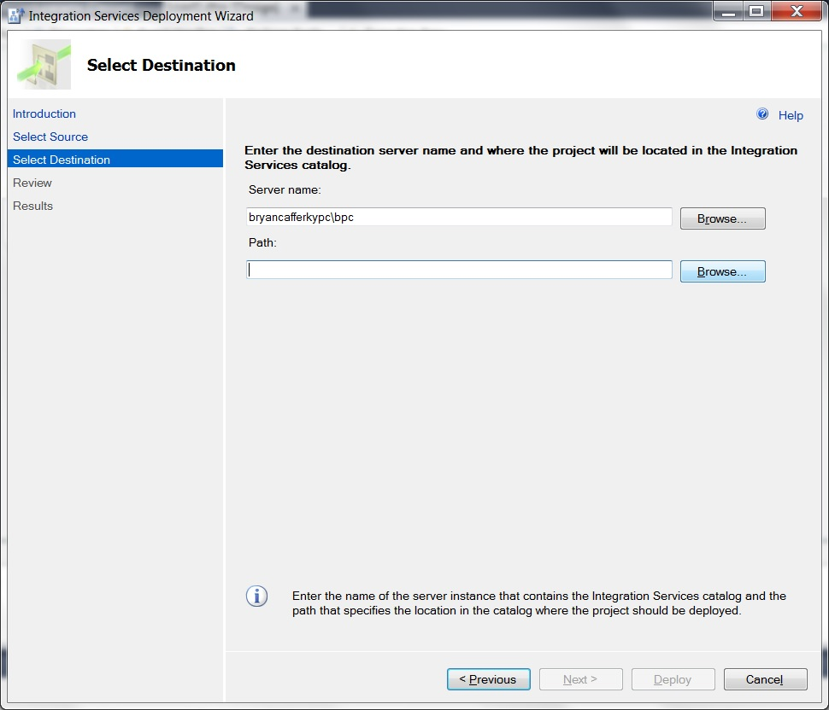
SSIS
Deploying a project – step 3
Enter the SQL Server Instance where the project should be deployed. Click Browse to locate the folder.

Slide 29
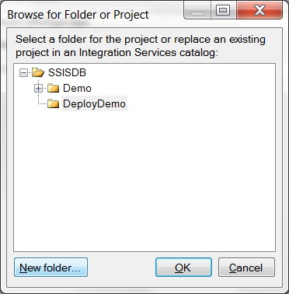
SSIS
Deploying a project – step 4
Select the folder or click on New Folder to create a one.

Slide 30
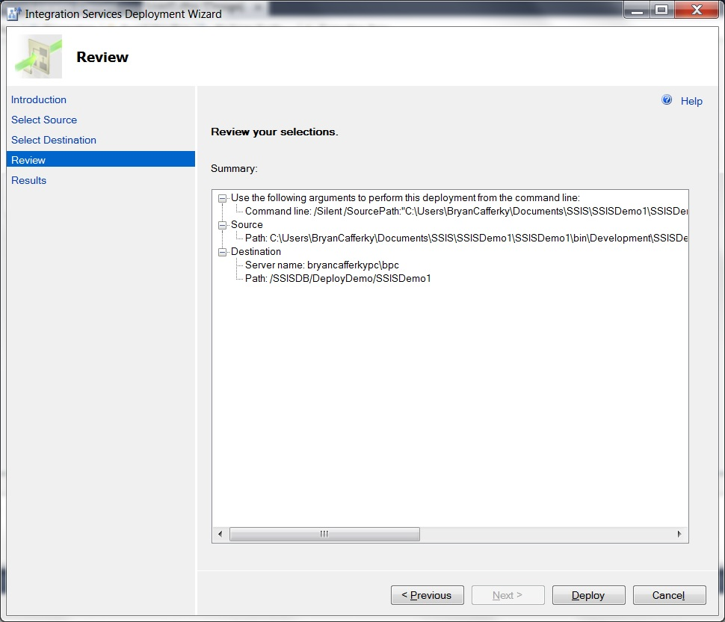
SSIS
Deploying a project – step 5
Verify the settings and click Deploy.

Slide 31
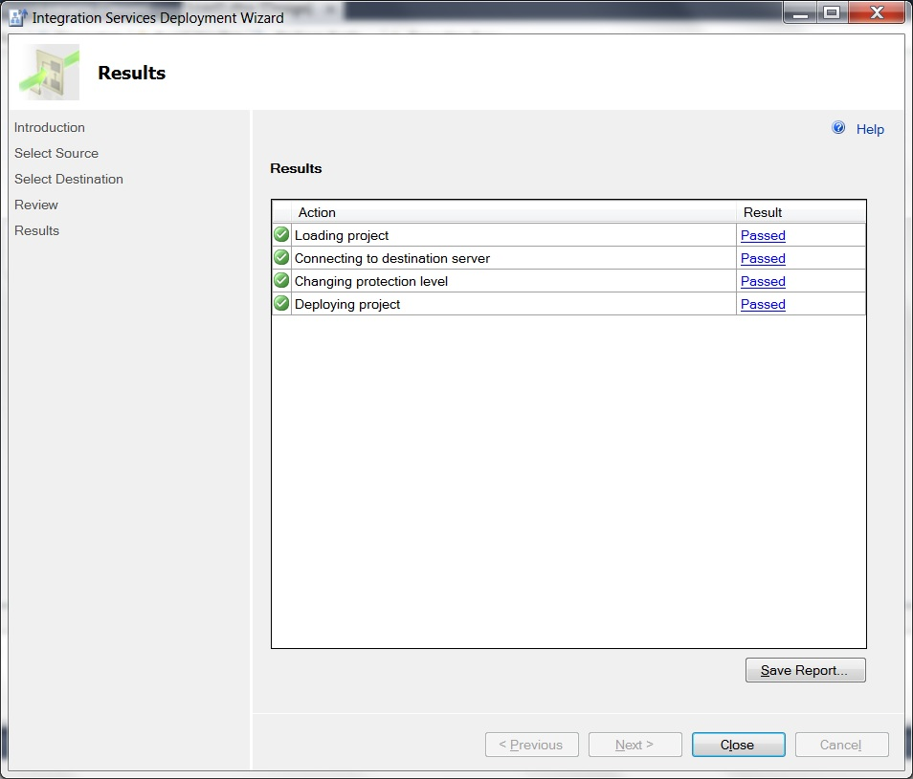
SSIS
Deploying a project – step 6
The deployment confirmation screen shows all tasks Passed. Click Close when ready.

Slide 32
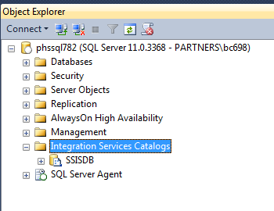
SSIS
New in 2012 – The Integration Services Catalog
Exposes Projects, Packages and Configurationns.

Slide 33
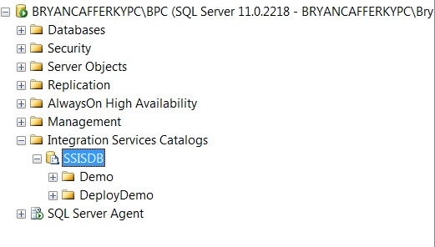
SSIS
New in 2012 – The Integration Services Catalog
Folders hold Projects and Environments.

Slide 34
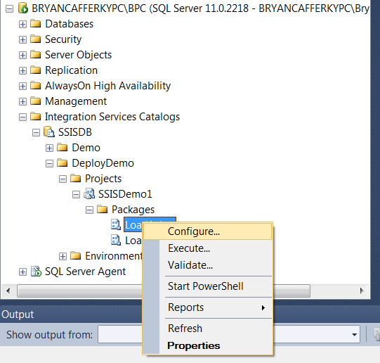
SSIS
New in 2012 – The Integration Services Catalog
Right Mouse Click on a Package or Project to get a Context Sensitive Menu. Select Configure.

Slide 35
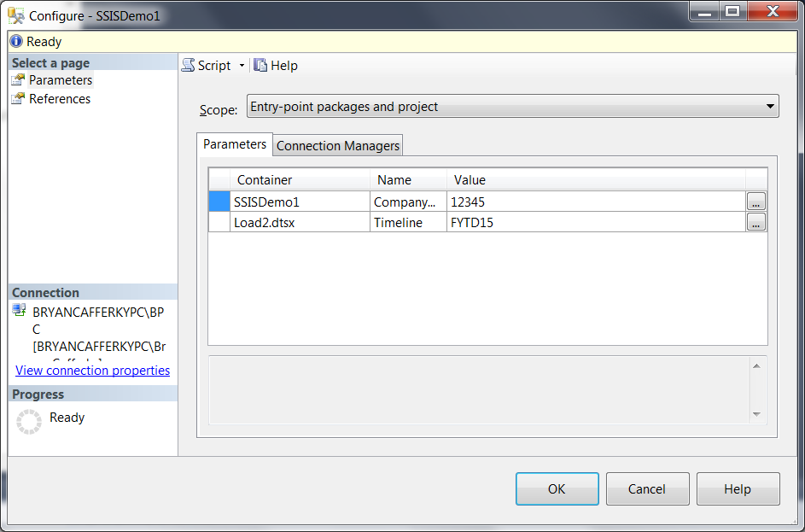
SSIS
New in 2012 – The Integration Services Catalog - Configuration
Enter values for Project Parameters and Connection Managers.

Slide 36
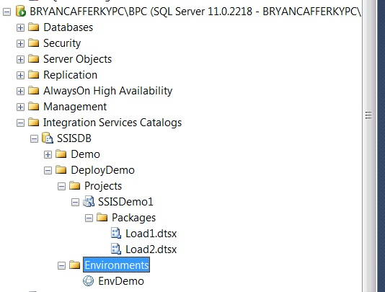
SSIS
New in 2012 – The Integration Services Catalog - Environments
SSIS Environment.
An Environment is just a set of Project Configuration Values stored
as an object in the catalog. The idea is that for each environment, Dev,
Integration, QA and Production, the configuration values will need to be
Different. SSIS Environments make this easier to manage.

Slide 37
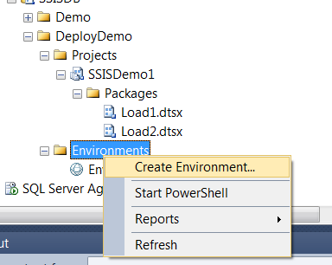
SSIS
New in 2012 – The Integration Services Catalog - Environments

Slide 38
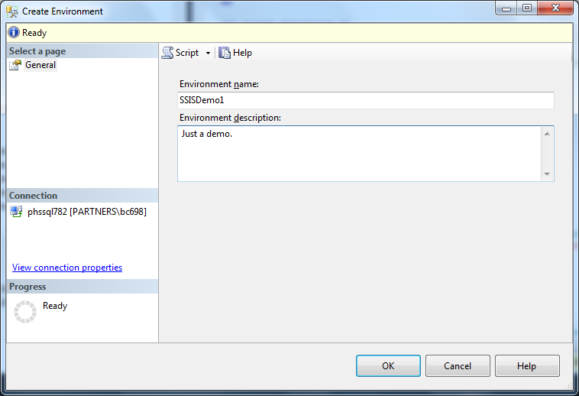
SSIS
New in 2012 – The Integration Services Catalog - Environments
Enter a named and description and click Ok.

Slide 39
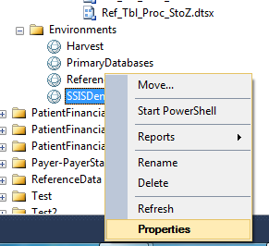
SSIS
New in 2012 – The Integration Services Catalog - Environments
Right Mouse Click and select Properties to edit.

Slide 40
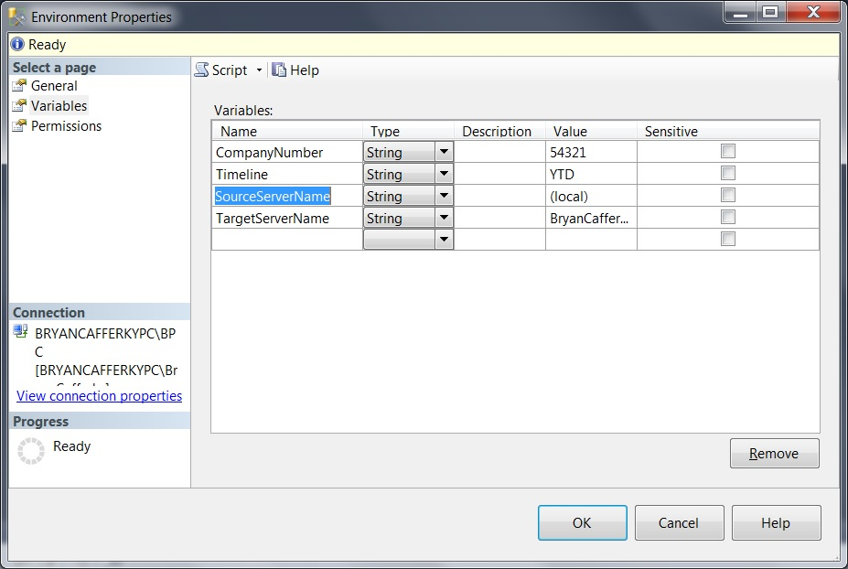
SSIS
New in 2012 – The Integration Services Catalog - Environments
Enter variable names and values. These will be assigned to configuration properties.

Slide 41
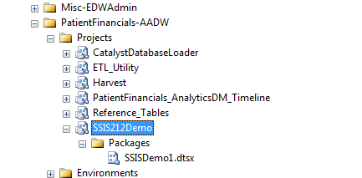
SSIS
New in 2012 – Configuration
You can see the project in the catalog.

Slide 42
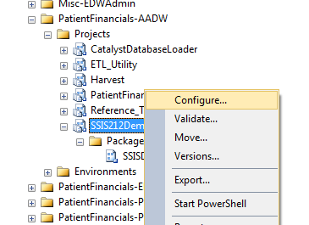
SSIS
New in 2012 – Configuration
Right mouse click on the Project and select Configure.

Slide 43
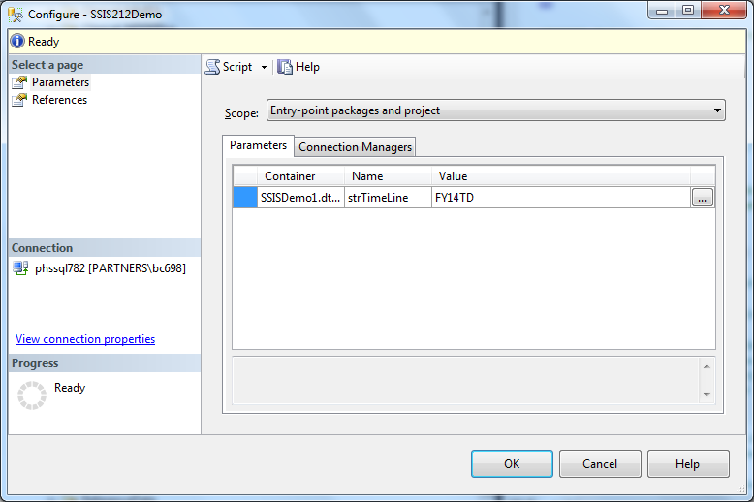
SSIS
New in 2012 – Configuration
Click on the refrences to configure.

Slide 44
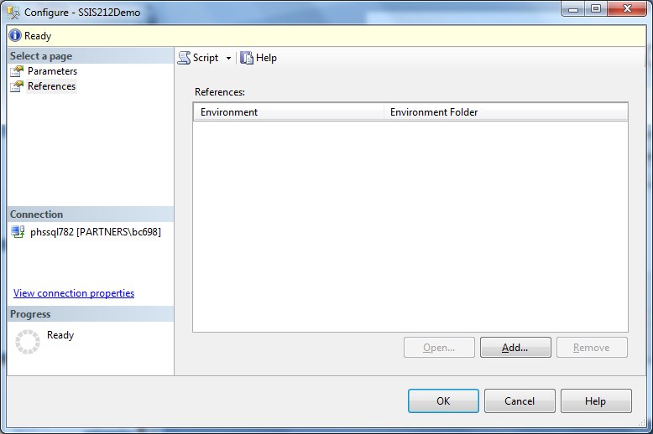
SSIS
New in 2012 – Configuration
Click on Add to add a reference to an Environment.

Slide 45
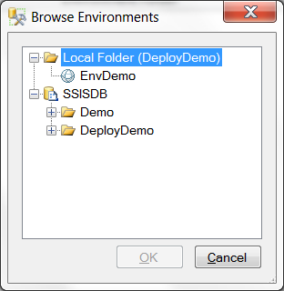
SSIS
New in 2012 – Configuration
Click on the environment and Ok.

Slide 46
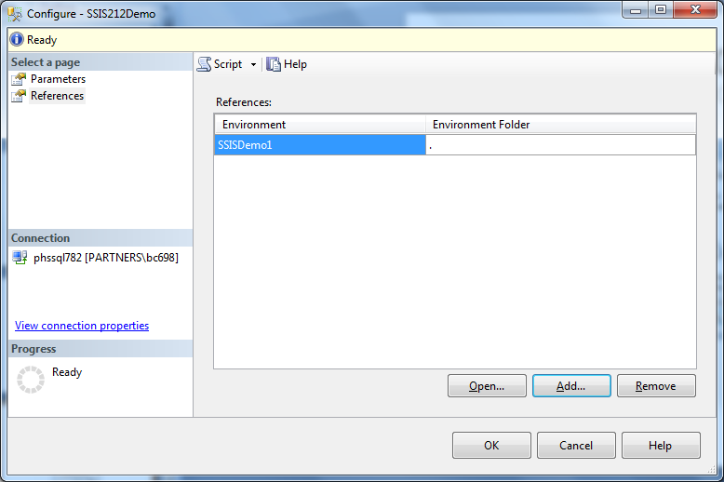
SSIS
New in 2012 – Configuration
You can see the reference was added..

Slide 47
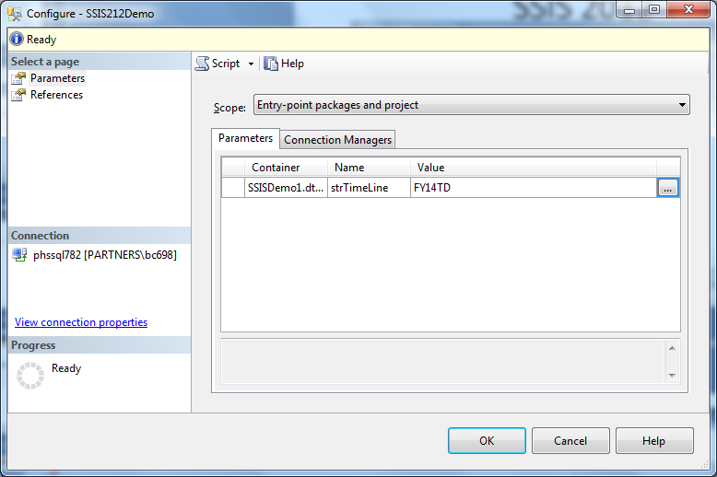
SSIS
New in 2012 – Configuration
Click on Parameters and then the ellipsis.

Slide 48
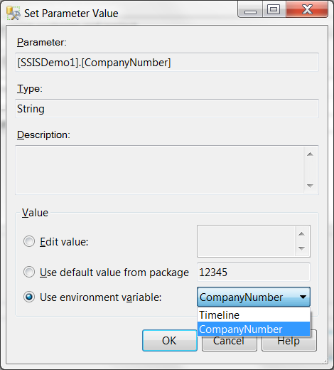
SSIS
New in 2012 – Configuration
Check Use Environment variable and select a variable.

Slide 49
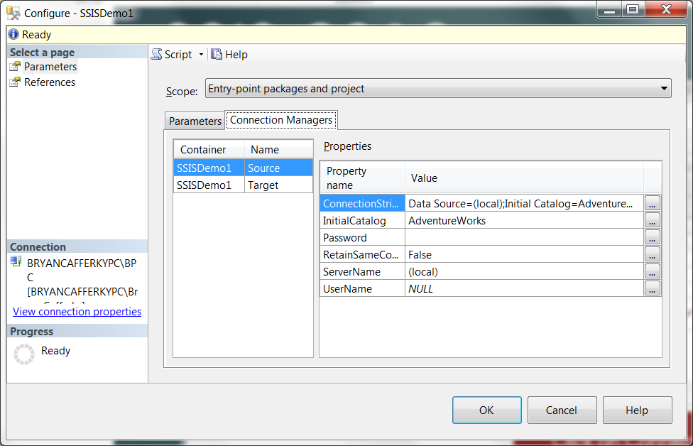
SSIS
New in 2012 – Configuration
Click on Connection Managers and the ellipsis next to ServerName.

Slide 50
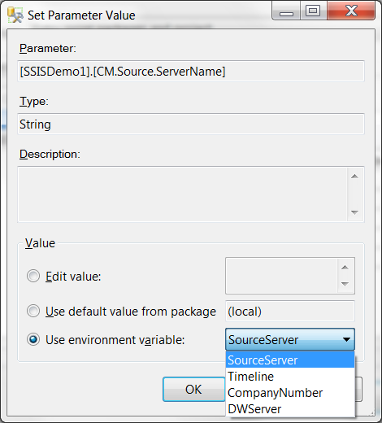
SSIS
New in 2012 – Configuration
Check ‘Use environment variable’ and select the variable from the drop down..

Slide 51
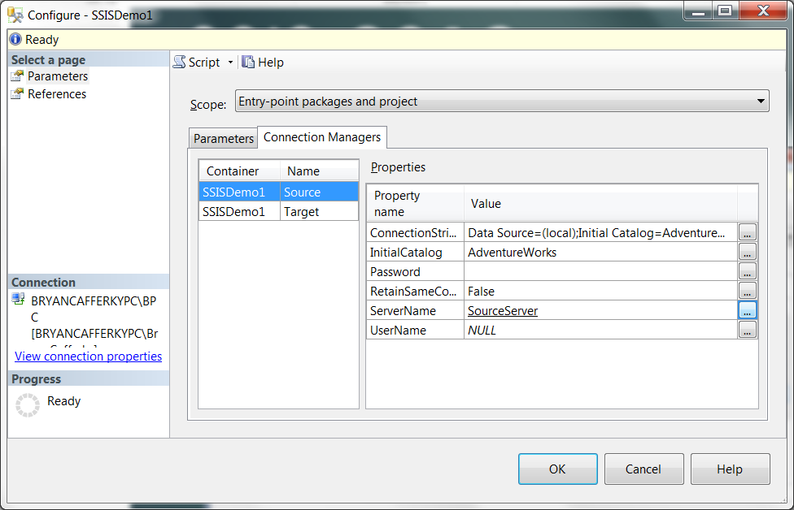
SSIS
New in 2012 – Configuration
Notice ServerName is now set to the environment variable name.

Slide 52
SSIS Plus
New in 2012 – Configuration
QA
Development
Production
SSIS Catalog
Project Folder
SSISProject1
SSISEnv1
Server=devserver
SSIS Catalog
SSISDemo Folder
SSISProject1
SSISEnv1
Server=qaserver
SSIS Catalog
SSISDemo Folder
SSISProject1
SSISEnv1
Server=prodserver
You can deploy the project to each server and it automatically picks up the
configuration settings for that server. Note: We are using relative references.

Slide 53
SSIS
Using SSIS with SQL Agent

Slide 54
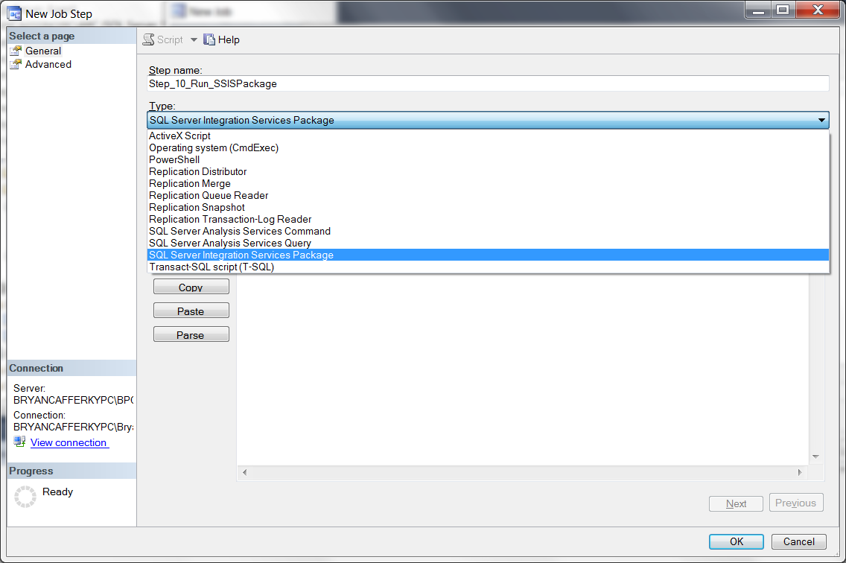
SSIS
Using SSIS with SQL Agent

Slide 55
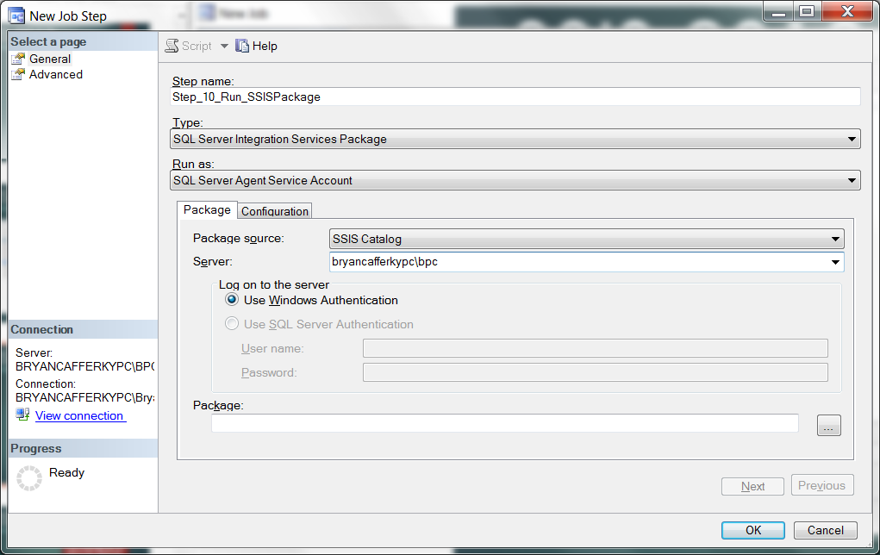
SSIS
Using SSIS with SQL Agent
After entering the server name, click the ellipsis next to the Package text box.

Slide 56
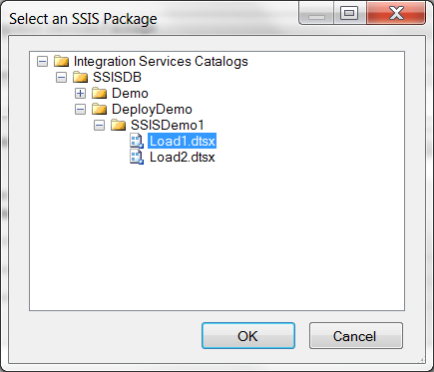
SSIS
Using SSIS with SQL Agent

Slide 57
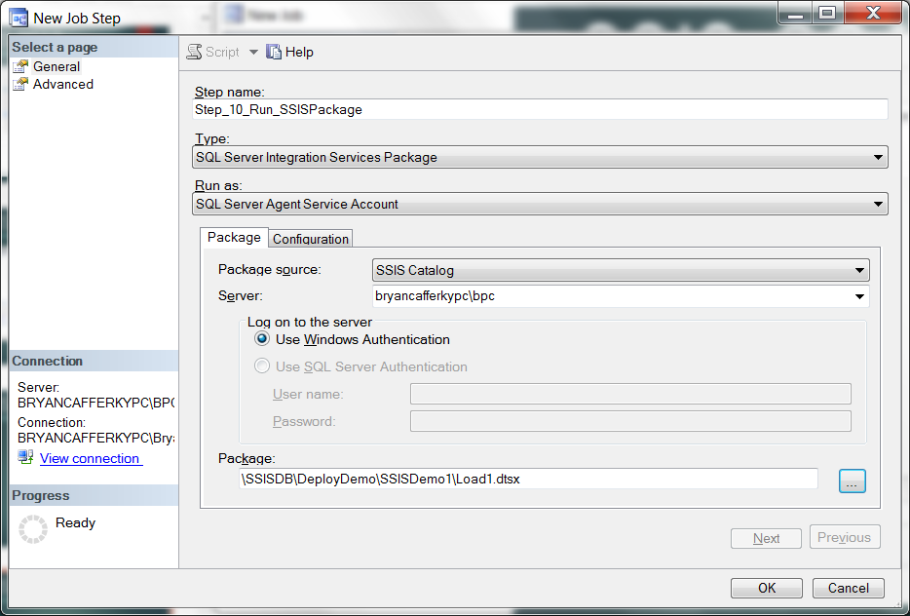
SSIS
Using SSIS with SQL Agent

Slide 58
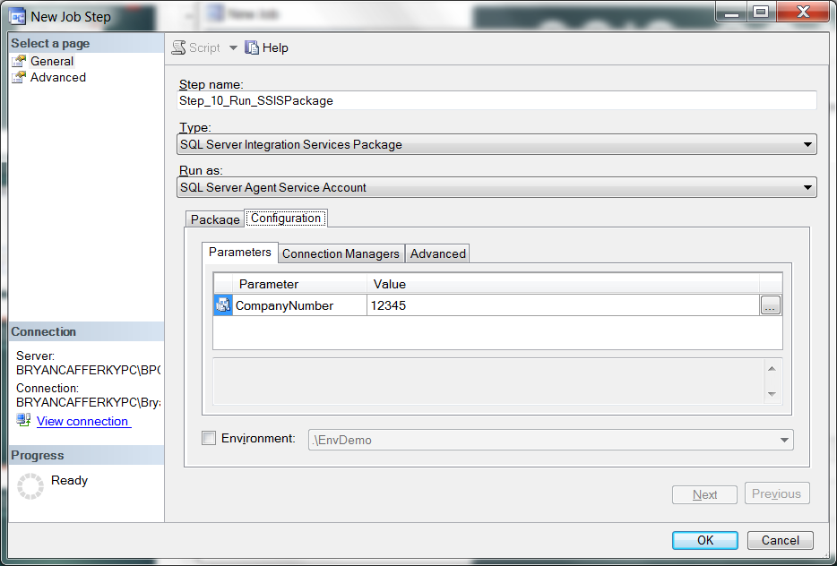
SSIS
Using SSIS with SQL Agent

Slide 59
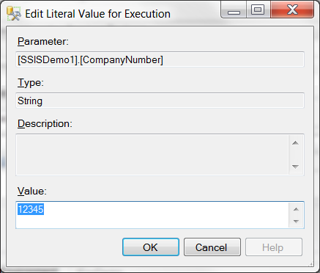
SSIS
Using SSIS with SQL Agent

Slide 60
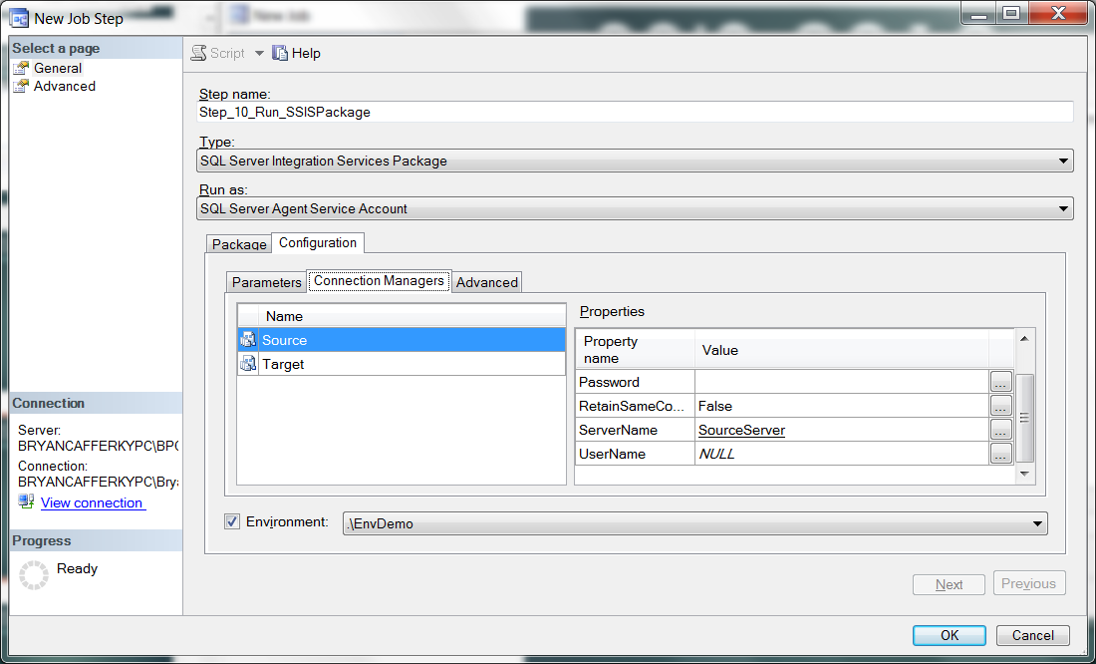
SSIS
Using SSIS with SQL Agent

Slide 61
SSIS
Using SSIS with SQL Agent
Can use package/project defaults.
Can use Environment variables.
Can be overridden with hard coded values.

Slide 62

SSIS
Using SSIS with SQL Agent

Slide 63

SSIS
Using SSIS with SQL Agent

Slide 64
SSIS
Built-in SSRS Reports

Slide 65

SSIS
New in 2012 – SSRS Reports
When a package fails, you need to view Reports from the catalog to get details.

Slide 66

SSIS
New in 2012 – SSRS reports
Click on All Messages for error details.

Slide 67
SSIS 2012+
New Architecture Addresses Many SSIS Limitations!
New SSIS Catalog in SQL Server managed via SSMS.
Built-in SSRS Reports on package executions.
Project Deployment Model: All the packages in the project are deployed together.
Configurable Project and Package parameters.
Environments – containers of configurations settings.
True database service execution.
Scale Out
Azure SSIS Support – ADFv2

Slide 68
SQL Server 2017

Slide 69
SQL Server 2016

Slide 70
SSIS+
Q & A

